Slide 1
WHISPER
3.0

Slide 2
Members
Zay Min Maw
Zin Linn Aung
Zin Min Nyi Nyi

Slide 3
Contents
Introduction
Module and description
Screen shots
Conclusion
Future Reference

Slide 4
Introduction
Our project is a chat application which is basically base on private(one by one or public chatting(message is broadcast to all connected users)
It is made of two application.
Clint application which runs on user’s PC.
Server application which runs on any PC on the network.
To start chatting, client should get connected to server.

Slide 5
Modules
Server Modules:-
A server is a specially equipped computer connected to the internet that allows users with chat clients to converse with one another via typed messages in real time.
Client Modules:-
A client is a software program that allows users to connect to chat servers and communicate with other users vis a chat room.

Slide 6
Tech-stack
Python
Tkinter for GUI
Mysql for database
Requests modules
End to end encryption
Threading
Pycryptodome modules

Slide 7
Property
Whisper is a chat app.
You can text message one by one or group privately.
It used small AI for the help-center which can show covid-19 data and weather data.

Slide 8
Encryption
Whisper used end to end encryption.
It used AES symmetric key algorithm.
AES is based on a design principle known as a substitution–permutation network, and is efficient in both software and hardware.Unlike its predecessor DES, AES does not use a Feistel network. AES is a variant of Rijndael, with a fixed block size of 128 bits, and a key size of 128, 192, or 256 bits. By contrast, Rijndael per se is specified with block and key sizes that may be any multiple of 32 bits, with a minimum of 128 and a maximum of 256 bits.

Slide 9
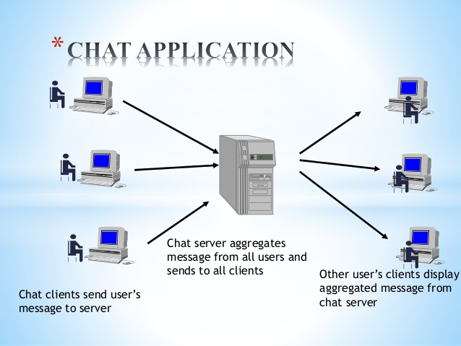

Slide 10
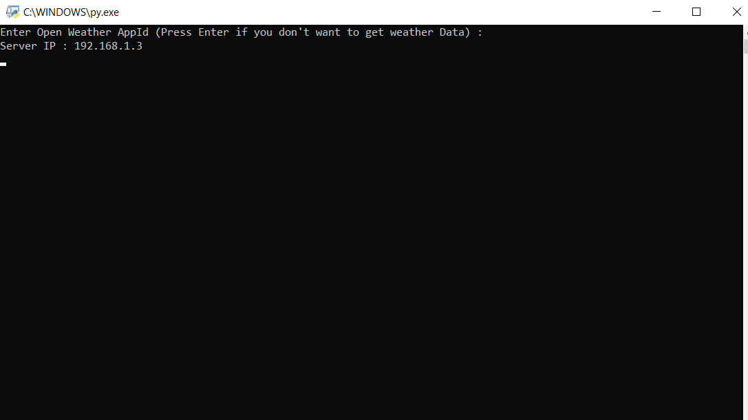
Server application
To create server
Enter your username and password
After this database will automatically
create for you
And it gives IP address of server

Slide 11
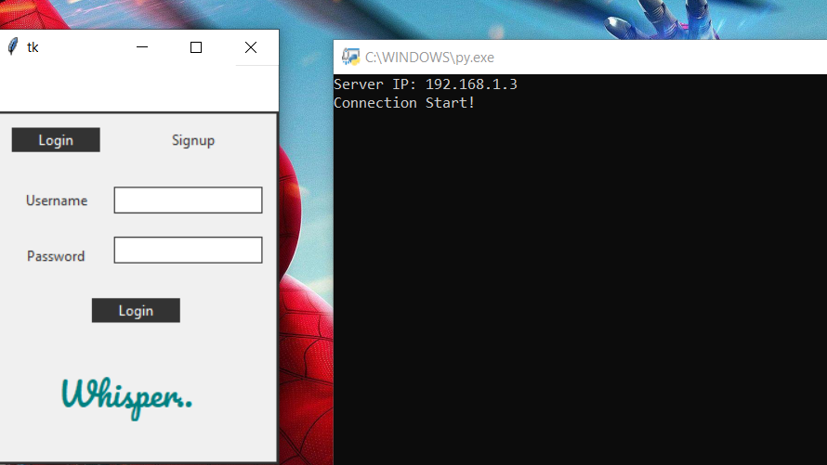
Client application
Here user enter the IP address of server
If client application is connected to server the login page will appear
Enter the valid user ID and password then click on submit button
If user is not registered then click on Signup and create new account

Slide 12
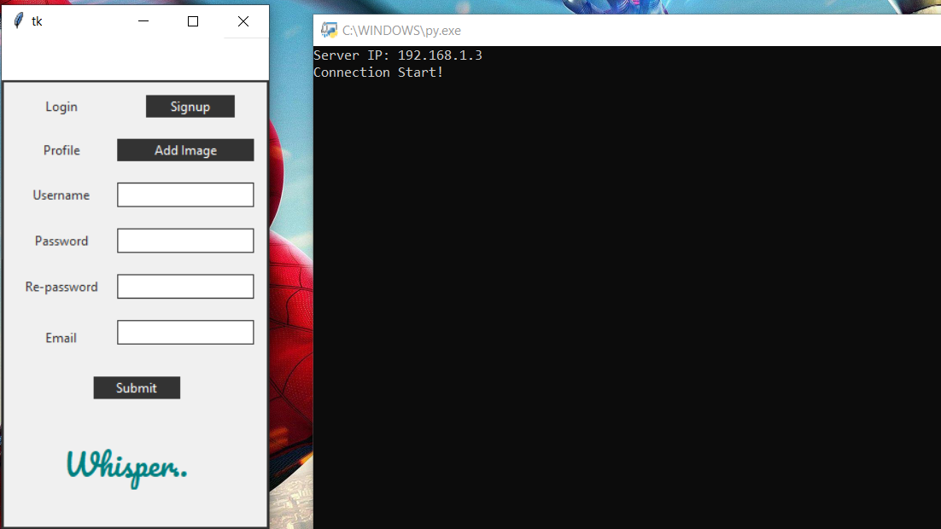
Signup page
Here user enter all the detail according to the registration page.
User must be enter the valid email ID.

Slide 13
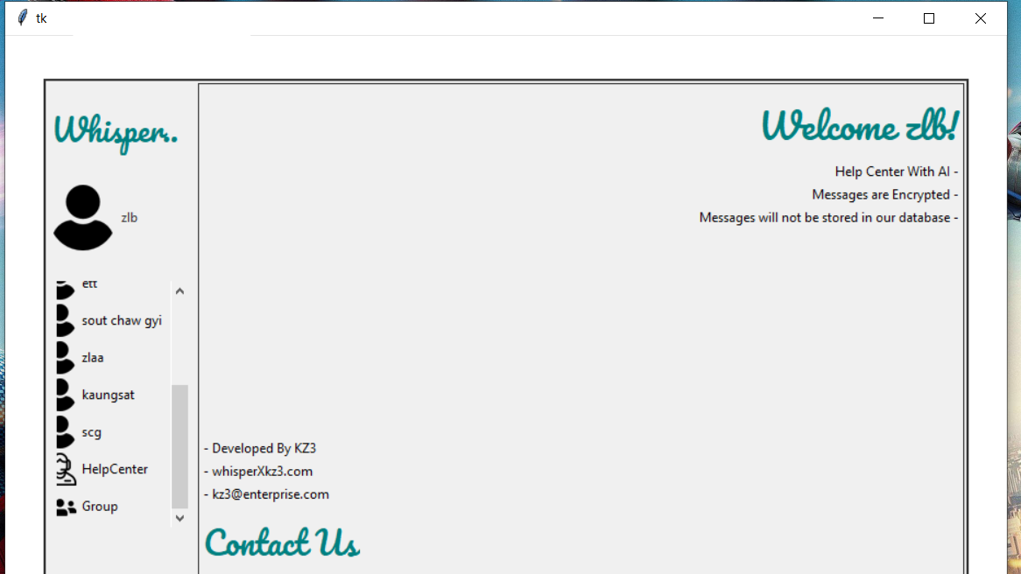
User’s home page

Slide 14
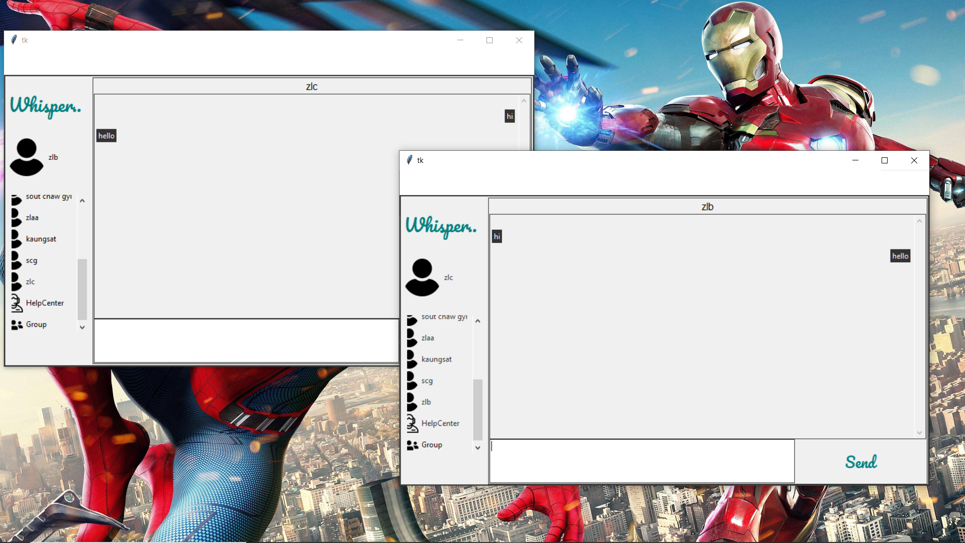
Private chat
Now you can chat anyone who is active.

Slide 15
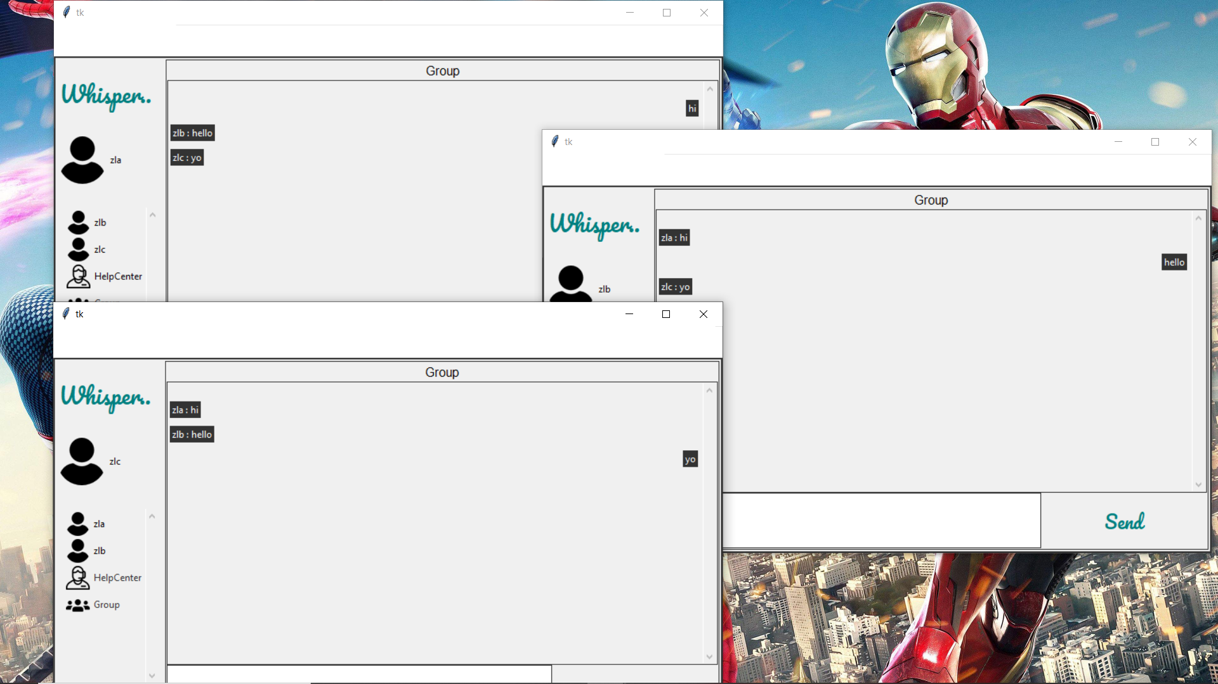
Group chat

Slide 16
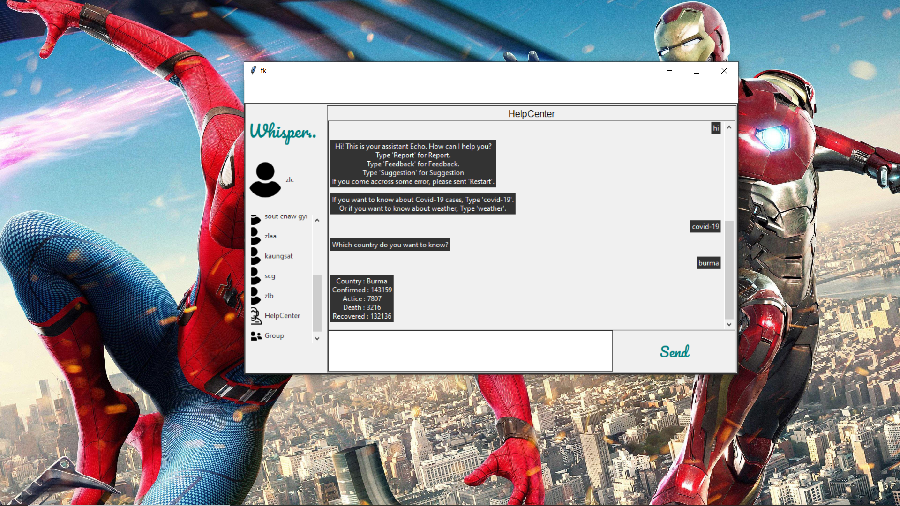
Help Center

Slide 17
Conclusion and Scope
There is always a room for improvements in any software package,
However good and efficient it my be done . But the most important thing should be flexible to accept further modification Right now we are just dealing with text communication . In future this software may be extended to include features such as:
File transfer : this will enable the user to send files of different formats to others via the chat application.
Voice chat : this will enhance the application to a higher level where communication will be possible via voice calling as in telephone.

Slide 18
THANK YOU

